Slide 1
Traceability Labels
Lear e-Systems - Electronics plants requirements
2025

Slide 2
Surface Mount Devices
Labeling Requirements
2025

Slide 3
Standard Lear label for Lear e-Systems Electronics
Correct traceability for electronic components require unique identification per package
The goal is to receive all inner-packages (reels or trays) for electronic components according to the Lear specification allowing labels to be read
The content, organization of the fields and formats used on the label are normalized for all Lear electronic plants, using market standards
With the objective to meet Traceability requirements on Auto industry

Slide 4
Sequence followed in the Standard Electronics Lear Label
Barcodes in the traceability label
20P Lear Part Number
Q Quantity
20T Lot number 8 digits - Must be unique and follow Lear instruction
20S Serial Number 8 digits - Must be unique and follow Lear instruction
21T Combination of 20T and 20S
16D Date code
          Production date from supplier
          To be used for component shelf-life control
2D Matrix Matrix 20P + 21T + Q
1P Supplier part number
1T Supplier Lot number

Slide 5
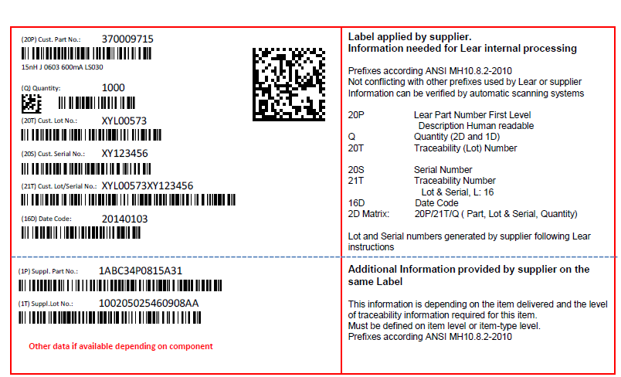
Sample of traceability label
with all required fields

Slide 6
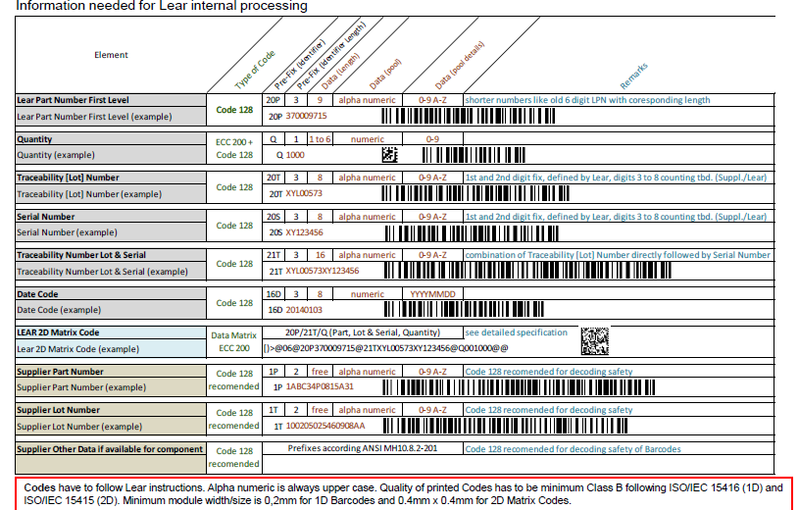
Tech fields – guidelines per field
in the traceability label

Slide 7

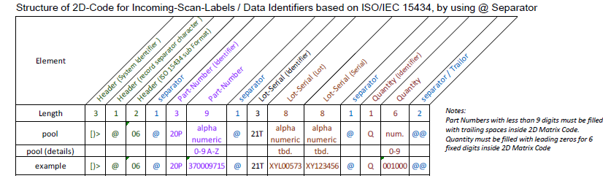
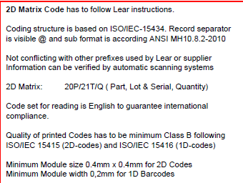
2D Matrix
In the traceability label

Slide 8
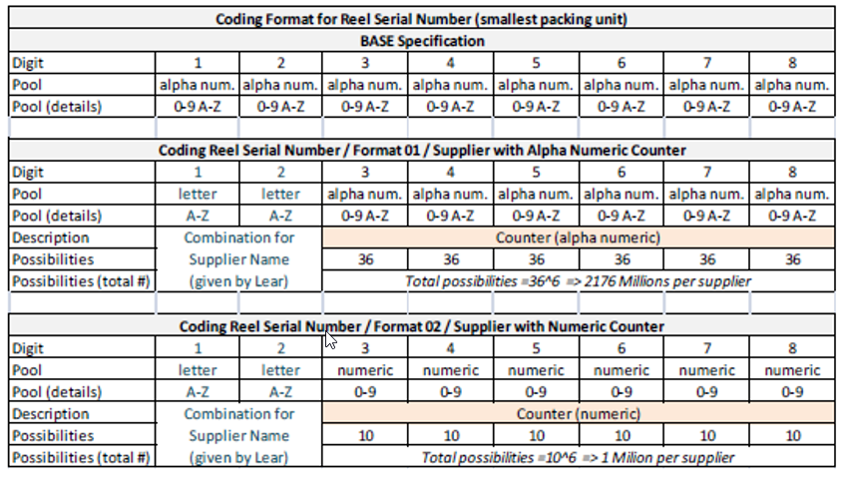
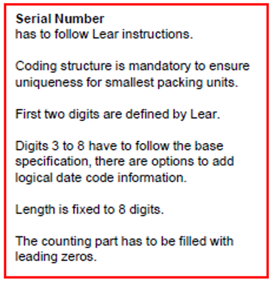
Counter 20S Serial Number. Base Spec. Formats 01-02
In the traceability label
Building Instruction for Counter 20S – Serial Number (smallest packing unit, i.e. SMD-Reel)

Slide 9
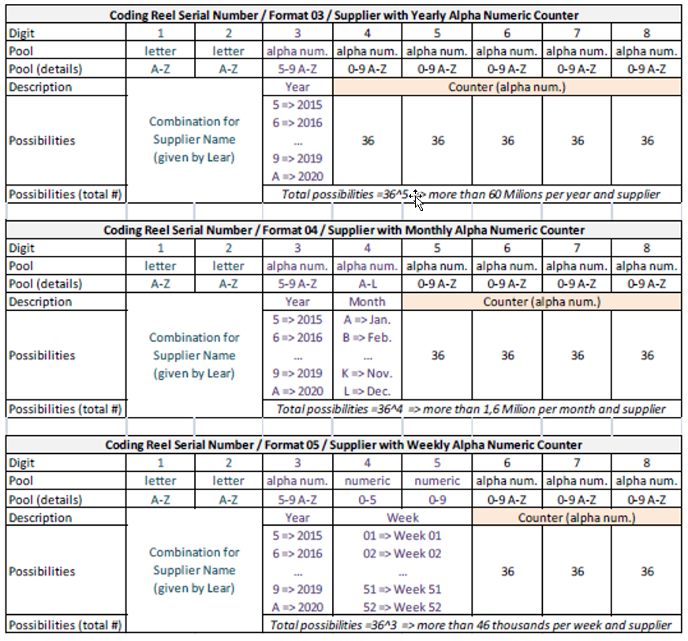
Counter 20S Serial Number – Formats 03-04-05
In the traceability label

Slide 10
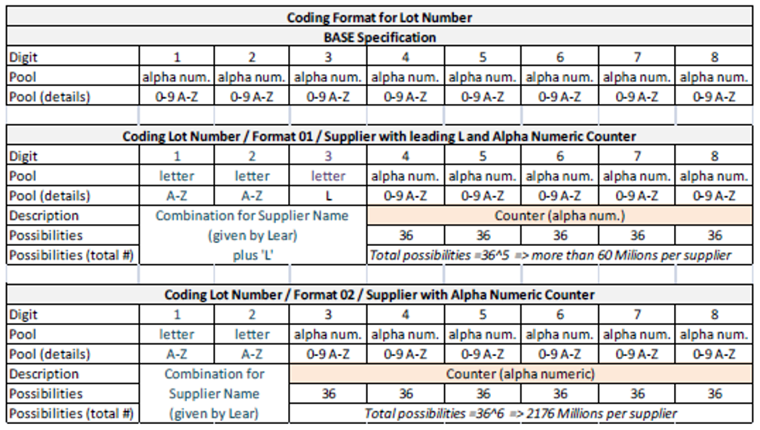
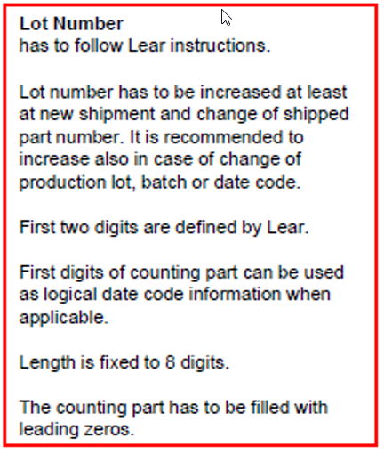
Counter 20T Lot Number. Base Spec. Formats 01-02
In the traceability label
Building Instruction for Counter 20T – Lot Number

Slide 11
Printed Circuit Boards
Labeling Requirements
2025

Slide 12
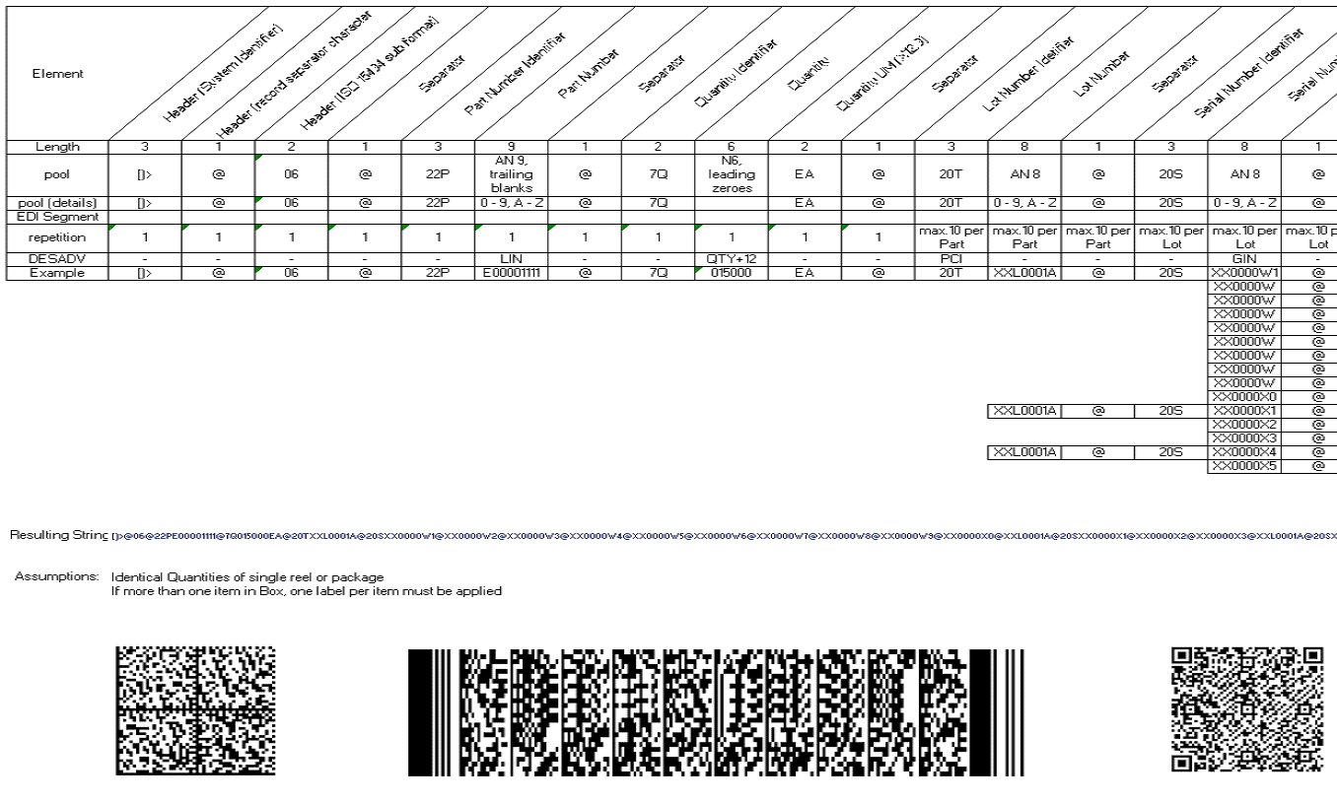
Special requirements for Printed Circuit Boards - PCB’s
Mother Box (Carton Box) Barcode Requirement
Choose any of the 3 types of matrix codes

Slide 13

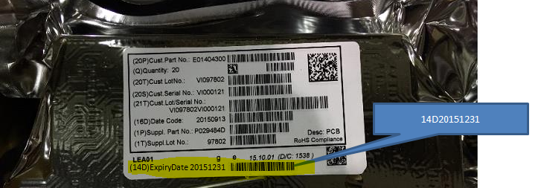
Other Special requirements for PCB’s
traceability label
Need to include Expiration Date on Smallest Package (i.e. Shielding Bag) label
Format: 14DYYYYMMDD (Code128 Barcode)
Example: 14D20151231

Slide 14
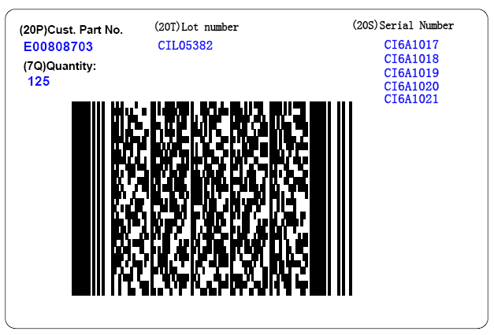
Outer Label for PCB’s
Labels on the Mother Box/Carton Box
(16D) Expiry Date
20151231
[)>@06@20PE00808703@16D20151231@7Q000125EA@20TCIL05382@20SCI6A1017@20SCI6A1018@20SCI6A1019@20SCI6A1020@20SCI6A1021@@

